Slide 1
Linear Regression

Slide 2
Linear Regression
Review

Slide 3
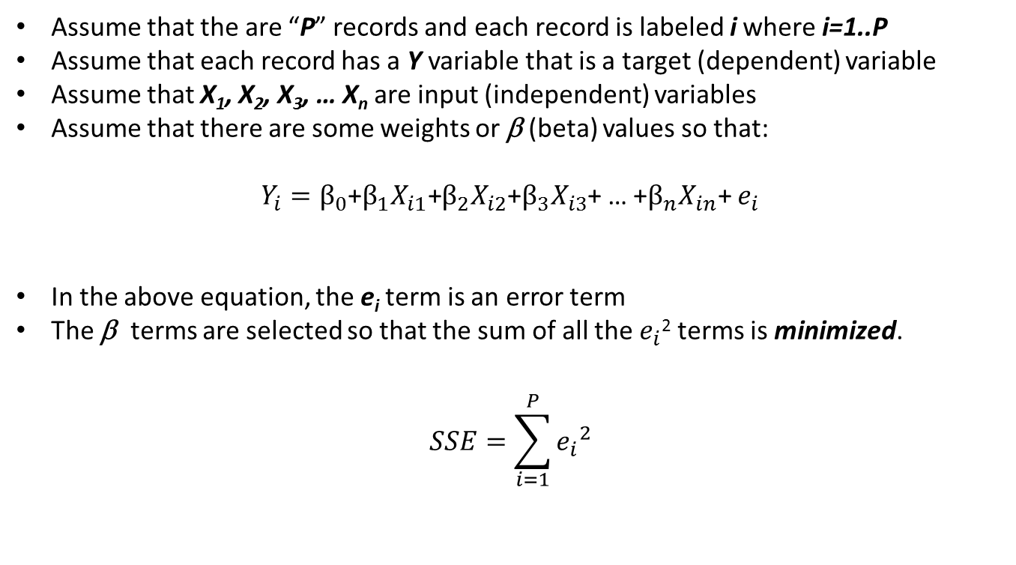
LINEAR REGRESSION Review
Assume that the are “P” records and each record is labeled i where i=1..P
Assume that each record has a Y variable that is a target (dependent) variable
Assume that X₁, X₂, X₃, … X_{n} are input (independent) variables
Assume that there are some weights or β (beta) values so that:
$Y_{i}=β_{0}$+$β_{1}X_{i1}\text{+}β_{2}X_{i2}$+$β_{3}X_{i3}$+ … +$β_{n}X_{in}\text{+}$ $e_{i}$
In the above equation, the e_{i} term is an error term
The β terms are selected so that the sum of all the $e_{i}$² terms is minimized.
$$SSE=\sum_{i=1}^{P}{{e_{i}}^{2}}$$

Slide 4
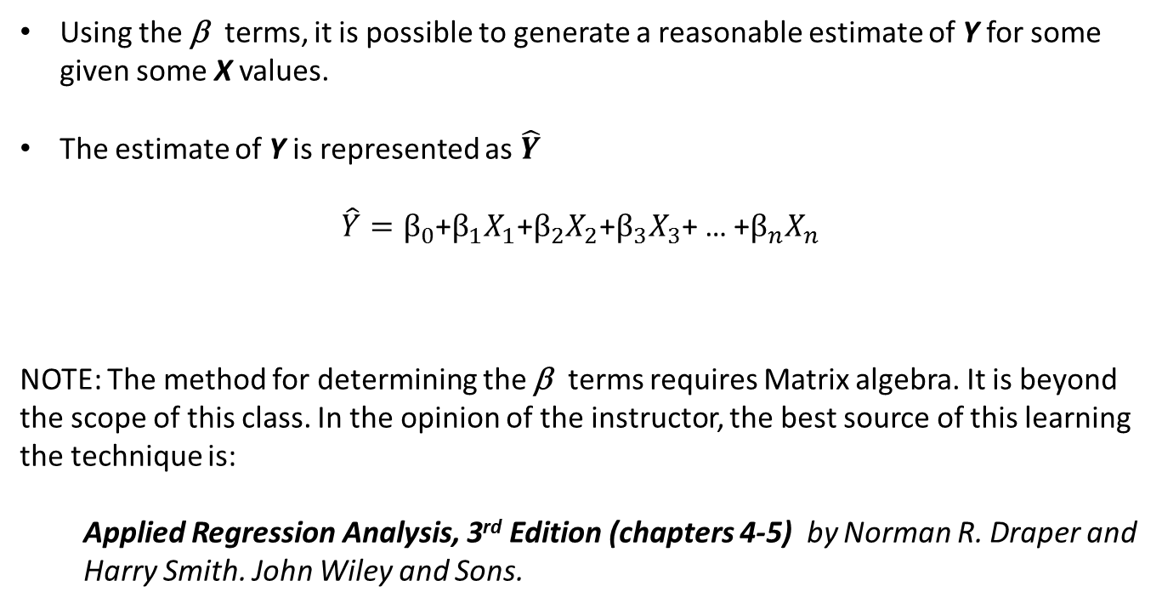
LINEAR REGRESSION Review
Using the β terms, it is possible to generate a reasonable estimate of Y for some given some X values.
The estimate of Y is represented as $\hat{Y}$
$\hat{Y}=β_{0}$+$β_{1}X_{1}\text{+}β_{2}X_{2}$+$β_{3}X_{3}$+ … +$β_{n}X_{n}$
NOTE: The method for determining the β terms requires Matrix algebra. It is beyond the scope of this class. In the opinion of the instructor, the best source of this learning the technique is:
Applied Regression Analysis, 3rd Edition (chapters 4-5) by Norman R. Draper and Harry Smith. John Wiley and Sons.

Slide 5
Linear Regression
Example

Slide 6
LINEAR REGRESSION: Example
This example is taken from the previously mentioned Draper and Smith reference.
The data describes monthly steam usage in a manufacturing plant
Y Monthly use of steam
X6 Operating days per month
X8 Average temperature in degrees Fahrenheit
NOTE: Draper and Smith named their variables X6 and X8, don’t worry about that. The names of the variables are not important and don’t affect the formula.
Raw Data is given on the following slide.
SAS Code is provided to read data into SAS

Slide 7
LINEAR REGRESSION: Example
Raw Steam Usage Data
 | X6 | X8 | Y
1 | 20 | 35.3 | 10.98
2 | 20 | 29.7 | 11.13
3 | 23 | 30.8 | 12.51
4 | 20 | 58.8 | 8.4
5 | 21 | 61.4 | 9.27
6 | 22 | 71.3 | 8.73
7 | 11 | 74.4 | 6.36
8 | 23 | 76.7 | 8.5
9 | 21 | 70.7 | 7.82
10 | 20 | 57.5 | 9.14
11 | 20 | 46.4 | 8.24
12 | 21 | 28.9 | 12.19
13 | 21 | 28.1 | 11.88
14 | 19 | 39.1 | 9.57
15 | 23 | 46.8 | 10.94
16 | 20 | 48.5 | 9.58
17 | 22 | 59.3 | 10.09
18 | 22 | 70 | 8.11
19 | 11 | 70 | 6.83
20 | 23 | 74.5 | 8.88
21 | 20 | 72.1 | 7.68
22 | 21 | 58.1 | 8.47
23 | 20 | 44.6 | 8.86
24 | 20 | 33.4 | 10.36
25 | 22 | 28.6 | 11.08

Slide 8
LINEAR REGRESSION: Example
SAS Data Step to read in raw data
data TEMPFILE;
input X6 X8 Y;
datalines;
20 35.3 10.98
20 29.7 11.13
23 30.8 12.51
20 58.8 8.40
21 61.4 9.27
22 71.3 8.73
11 74.4 6.36
23 76.7 8.50
21 70.7 7.82
20 57.5 9.14
20 46.4 8.24
21 28.9 12.19
21 28.1 11.88
19 39.1 9.57
23 46.8 10.94
20 48.5 9.58
22 59.3 10.09
22 70.0 8.11
11 70.0 6.83
23 74.5 8.88
20 72.1 7.68
21 58.1 8.47
20 44.6 8.86
20 33.4 10.36
22 28.6 11.08
;
run;

Slide 9
LINEAR REGRESSION: Example
SAS has many procs that can do Linear Regression. Here are three:
proc reg data=TEMPFILE;
model Y = X6 X8;
run;
quit;
proc glm data=TEMPFILE;
model Y = X6 X8;
run;
quit;
proc genmod data=TEMPFILE;
model Y = X6 X8 / link=identity dist=normal;
run;

Slide 10
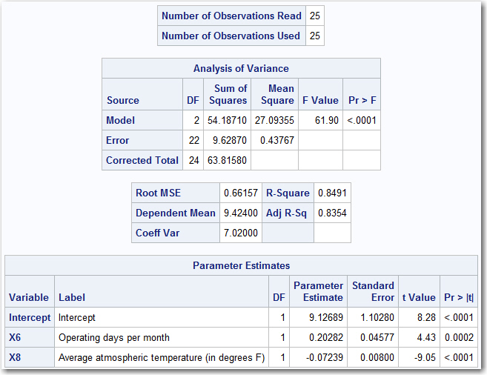
LINEAR REGRESSION: Example
Here are the results from PROC REG

Slide 11
LINEAR REGRESSION: Example
Here are the results from PROC REG
Beta Values

Slide 12
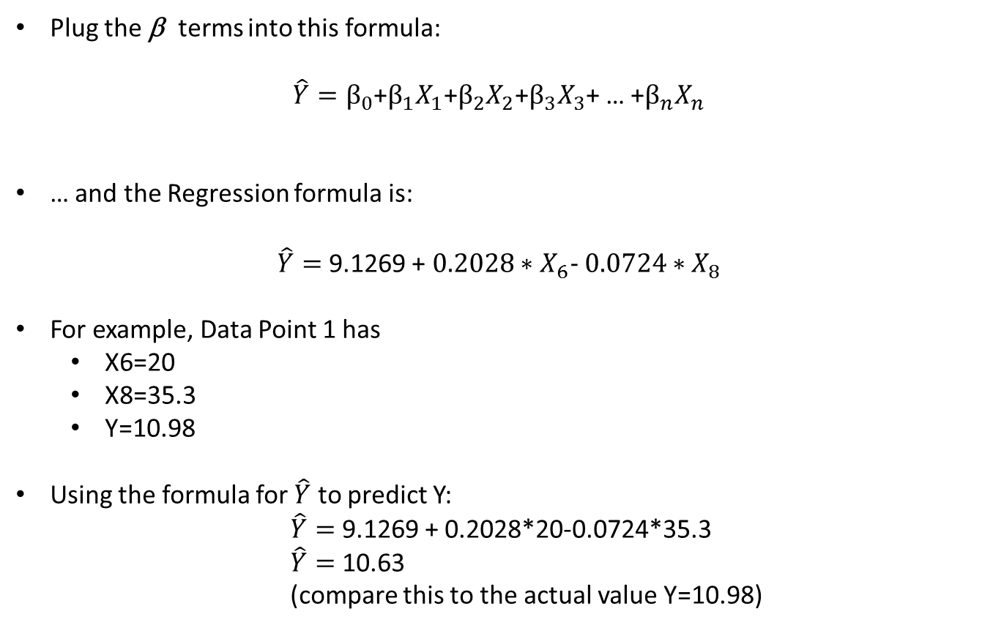
LINEAR REGRESSION: Example
Plug the β terms into this formula:
$\hat{Y}=β_{0}$+$β_{1}X_{1}\text{+}β_{2}X_{2}$+$β_{3}X_{3}$+ … +$β_{n}X_{n}$
… and the Regression formula is:
$\hat{Y}=$ 9.1269 +${ 0.2028∗X}_{6}\text{−} 0.0724∗X_{8}$
For example, Data Point 1 has
X6=20
X8=35.3
Y=10.98
Using the formula for $\hat{Y}$ to predict Y:
$\hat{Y}=$ 9.1269 + 0.2028*20-0.0724*35.3
$\hat{Y}=$ 10.63
(compare this to the actual value Y=10.98)

Slide 13
LINEAR REGRESSION: Example
All the data points and estimated output are given below. The estimated values are given in “Y-hat” and the errors are in “e”.
 | X6 | X8 | Y | Y-hat | e
1 | 20 | 35.3 | 10.98 | 10.63 | 0.35
2 | 20 | 29.7 | 11.13 | 11.03 | 0.10
3 | 23 | 30.8 | 12.51 | 11.56 | 0.95
4 | 20 | 58.8 | 8.4 | 8.93 | -0.53
5 | 21 | 61.4 | 9.27 | 8.94 | 0.33
6 | 22 | 71.3 | 8.73 | 8.43 | 0.30
7 | 11 | 74.4 | 6.36 | 5.97 | 0.39
8 | 23 | 76.7 | 8.5 | 8.24 | 0.26
9 | 21 | 70.7 | 7.82 | 8.27 | -0.45
10 | 20 | 57.5 | 9.14 | 9.02 | 0.12
11 | 20 | 46.4 | 8.24 | 9.82 | -1.58
12 | 21 | 28.9 | 12.19 | 11.29 | 0.90
13 | 21 | 28.1 | 11.88 | 11.35 | 0.53
14 | 19 | 39.1 | 9.57 | 10.15 | -0.58
15 | 23 | 46.8 | 10.94 | 10.40 | 0.54
16 | 20 | 48.5 | 9.58 | 9.67 | -0.09
17 | 22 | 59.3 | 10.09 | 9.30 | 0.79
18 | 22 | 70 | 8.11 | 8.52 | -0.41
19 | 11 | 70 | 6.83 | 6.29 | 0.54
20 | 23 | 74.5 | 8.88 | 8.40 | 0.48
21 | 20 | 72.1 | 7.68 | 7.96 | -0.28
22 | 21 | 58.1 | 8.47 | 9.18 | -0.71
23 | 20 | 44.6 | 8.86 | 9.95 | -1.09
24 | 20 | 33.4 | 10.36 | 10.76 | -0.40
25 | 22 | 28.6 | 11.08 | 11.52 | -0.44

Slide 14
LINEAR REGRESSION: Example
SAS Macro to score data using Linear regression model.
%macro SCORE( INFILE, OUTFILE );
data &OUTFILE.;
set &INFILE.;
YHAT = 9.12689 + 0.20282*X6 - 0.07239*X8;
run;
%mend;
SAS code to create a New Data Set. This data set will be scored using the MACRO
data NEWFILE;
input X6 X8;
datalines;
25 35.0
24 30.0
23 25.5
22 40.0
21 15.5
;
run;

Slide 15
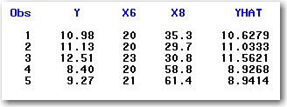
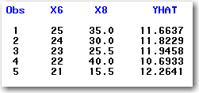
LINEAR REGRESSION: Example
SAS Code to invoke the macro and score the original data set and also the new data set. The code will print out the first 5 observations of each scored data set.
%SCORE( TEMPFILE, SCOREFILE );
%SCORE( NEWFILE, NEWSCORE );
proc print data=SCOREFILE(obs=5);
run;
proc print data=NEWSCORE(obs=5);
run;
Output of both print statement
Scored TEMPFILE Scored NEWFILE

Slide 16
Linear Regression
Assumptions

Slide 17
LINEAR REGRESSION Assumptions
Linear Regression assumes the following
criteria about the data will be met:
Independence: All the observations (records) are independent from one another
Linearity: The target (dependent) variable is a linear combination of the input (independent) variables.
Multicollinearity: There is no perfect correlation between independent variables.
Error Terms:
The error terms have a mean or average value of zero
The error terms are normally distributed
There is no observable pattern to the error terms (homoscedastic).

Slide 18
LINEAR REGRESSION Assumptions
What if the Linear Regression model violates any assumption?
Linear Regression is robust. Even if the assumptions of linear regression are violated, the regression model can still produce good results.
- Paraphrasing the work of JOHN TUKEY
“All models are wrong, but some are useful”
- George E. P. Box
Linear regression is simple and powerful. If you can get away with using it as a predictive model, then do so. Even if it means taking a few liberties.
- Opinion of Donald Wedding

